Slide 1
Network diagnostics
Notes:
[Sources]
- Πρότυπο: A4.M2 Πολυμέσα-Ήχος(2).pptx
[/Sources]

Slide 2
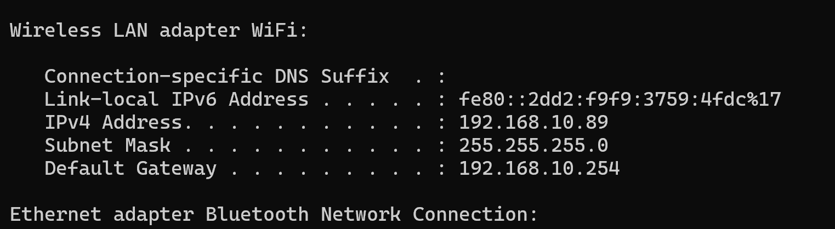
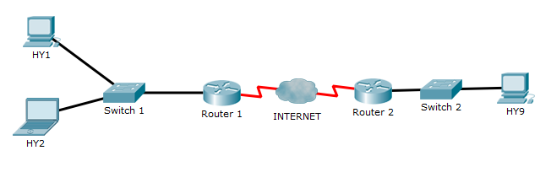
Network settings
A.5.M2 | Theory
IP Address
the address of this device (e.g. 192.168.10.89).
Subnet Mask
the subnet address: four numbers, usually 255 or 0, e.g. 255.255.255.0.
Default Gateway
the address of the router that forwards data to other networks (e.g. 192.168.10.254).
Notes:
[Sources]
- Τετράδιο Εργασιών Πληροφορικής Α΄ Λυκείου, A.5.M2, Δραστηριότητες Εμπέδωσης, σελ. 87–89
- Σημειώσεις Πληροφορικής Α΄ Λυκείου, ενότητα Α.5
[/Sources]

Slide 3
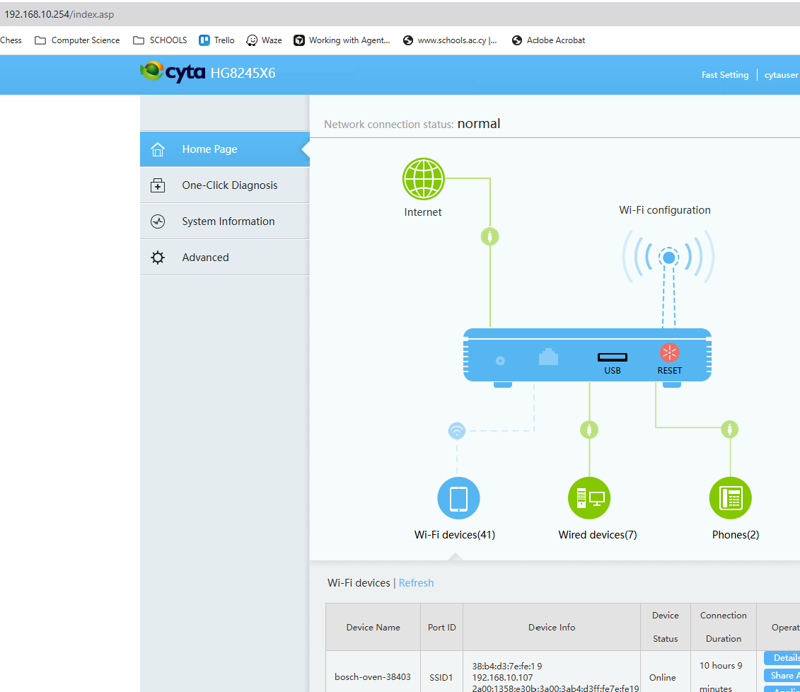
Local Network

Slide 4
What is a subnet?
A subnet is a group of devices whose IP addresses share the same network portion.
Mask 255.255.255.0 (/24): the first three parts of the IP address identify the network.
255 = the same part for all devices
0 = different
Device | IP Address | Network (/24) | Relation to PC A
PC A | 192.168.1.10 | 192.168.1.0 | Reference device
PC B | 192.168.1.25 | 192.168.1.0 | Same subnet
Printer | 192.168.1.200 | 192.168.1.0 | Same subnet
Laptop | 192.168.2.10 | 192.168.2.0 | Different subnet
192.168.1.10 and 192.168.1.25 communicate within the same subnet. Communication with 192.168.2.10 requires a router or Default Gateway.
Notes:
[Sources]
- Θεωρία και Φύλλο Εργασίας A.5.M2, σχολικά βιβλία Πληροφορικής Α΄ Λυκείου
[/Sources]

Slide 5
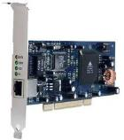
Subnets
A.5.M2 | Theory
Same subnet
Two devices on the same subnet can communicate without an intermediate router.
Different network
When the destination is on another network, the device sends the packets to the Default Gateway.
Unique addresses
Each active device needs a different IP address on the same network.
Notes:
[Sources]
- Τετράδιο Εργασιών Πληροφορικής Α΄ Λυκείου, A.5.M2, Δραστηριότητες Εμπέδωσης, σελ. 87–89
- Σημειώσεις Πληροφορικής Α΄ Λυκείου, ενότητα Α.5
[/Sources]

Slide 6
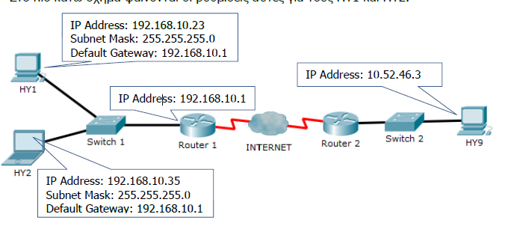
Network settings
A.5.M2 | Theory
PC1
• IP Address: 192.168.10.23
• Subnet Mask: 255.255.255.0
• Default Gateway: 192.168.10.1
sending data to the device with IP address 192.168.10.35
applies the Subnet Mask and finds that the first three numbers match its own address (192.168.10).
sending data to the device with IP address 192.168.2.5
applies the Subnet Mask and finds that the first three numbers differ from its own address (192.168.10 and 192.168.2).
Notes:
[Sources]
- Τετράδιο Εργασιών Πληροφορικής Α΄ Λυκείου, A.5.M2, Δραστηριότητες Εμπέδωσης, σελ. 87–89
- Σημειώσεις Πληροφορικής Α΄ Λυκείου, ενότητα Α.5
[/Sources]

Slide 7
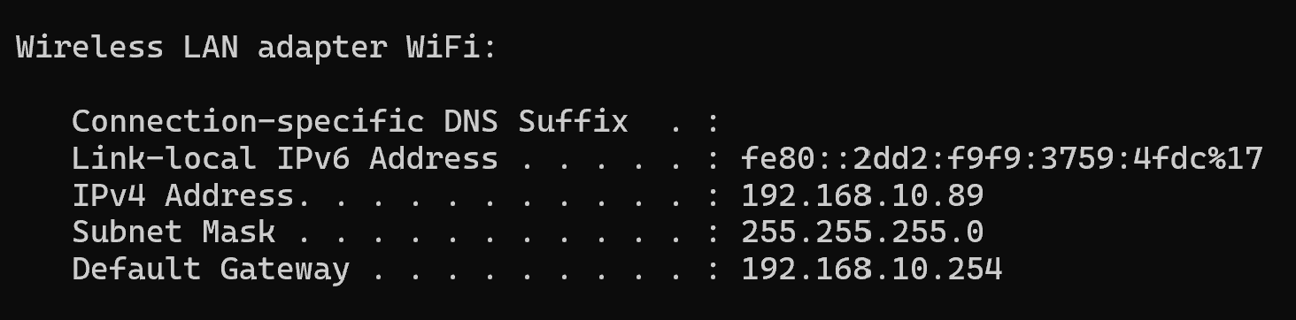
ipconfig (troubleshooting)
The commands display the computer's network settings in Windows. They do not change any settings.
ipconfig basic information
ipconfig /all full details
Use: check whether the computer has the correct IP address, mask, gateway and DNS.
Notes:
[Sources]
- Θεωρία και Φύλλο Εργασίας A.5.M2, σχολικά βιβλία Πληροφορικής Α΄ Λυκείου
[/Sources]

Slide 8
Practice Activities
A.5.M2
Answer the following
Questions 1–4 from Worksheet A.5.M2.
Run an Internet speed test in the lab using your browser.
Repeat the test at home using your smartphone.
Notes:
[Sources]
- Τετράδιο Εργασιών Πληροφορικής Α΄ Λυκείου, A.5.M2, Δραστηριότητες Εμπέδωσης, σελ. 87–89
- Σημειώσεις Πληροφορικής Α΄ Λυκείου, ενότητα Α.5
[/Sources]

